Slide 1
CAP Strategic Plan Measure 3 – “Empowering Communities to act as Environmental Stewards

Slide 2
Agenda
Mr Pierre Louis Attard- Gozo Action Group Foundation (GAGF)
Ms Paula Azzopardi - Agriculture and Rural Payments Agency (ARPA)
Mr Andrea Camilleri- Servizzi Ewropej f’Malta (SEM)

Slide 3
The Gozo Action Group Foundation
Founded in 2009, the GAGF has been able to continuously reach its aim through the ongoing opportunity of administering the EU Funded LEADER Programme in the Gozo Region.
The aim of the GAGF is to create more opportunities for NGOs, Local Councils, and other entities.
GAGF has been selected as the Local Action Group (LAG) for the Għawdex territory, to implement the LEADER programme under the Common Agricultural Policy 2023 – 2027 programming period.

Slide 4
The GAGF is directed by a Decision Committee consisting of 7 members: 3 from the Public Sector and 4 from the Private Sector.
Members from the Private Sectors:
Gozo Business Chambers
Gozo NGOs Associations
Gozo Tourism Association
Gozo Confederations of Agriculture & Fisheries
Others
Members from the Public Sector
All of the 14 Gozitan Local Councils

Slide 5
History of the L.E.A.D.E.R. Programme
Established in 1991, the programme is financed by the European Agricultural Fund for Rural Development (EAFRD).
Introduced locally in the 2007-2013 Rural Development Programme (RDP).
Operates with a bottom-up approach which includes stakeholder from various sectors.
Aims to:
Support small-scale community projects
Increase capacity of local rural communities and business networks
Encourage innovation and cooperation to address local development objectives
These aims are addressed through the Local Development Strategy and are tailored to each territory.
Malta consists of 3 territories and has 3 LAG’s: GAL Majjistral Foundation, the GAL Xlokk Foundation and the Gozo Action Group Foundation

Slide 6
CAP Strategic Plan 2023-2027
Measure 1: Keeping the Culture and Traditions of Gozo Alive
Aim & Scope:
➢ The objective is to enable the distinctive elements of the culture and traditions of Gozo to enhance the quality of life.
➢ This measure will support actions culminating in the holding of at least one event which will feature attractions and activities spread out at different locations.

Slide 7
Measure 2: Youth entrepreneurship in Gozo: Taking Ideas to the Marketplace
Aim & Scope:
➢ This measure will support youths and micro enterprises to develop creative business ideas which can benefit the rural society of Gozo as well as support youths who are already in a business activity but may wish to diversify, further their business or tap into other markets. ➢The aim is to aid youths with creative ideas to develop business concepts and ideas, acquire skills and knowledge, and develop information and demonstration materials.

Slide 8
Measure 3: Empowering Communities to act as Environmental Stewards
Aim & Scope:
➢ The general aim of this measure is to improve the quality of the environment of the Region through small-scale initiatives within the territory.
➢ This measure will enable communities to put into action small-scale plans aimed at improving the quality of life through interventions that would address water conservation, climate change, biodiversity, waste management and emissions to the environment.

Slide 9
Measure 4: Promoting Health and Sustainable Lifestyle in Gozo
Aim & Scope:
➢ This measure can allow for the development of amenities such as open spaces, which can be enjoyed by the community for social activities, promotion of healthy diets (with an emphasis on local gastronomy) and mental well-being.
➢ Activities towards the provision of animal therapy and public safety within rural areas are also applicable under this Measure.

Slide 10
Aim & Scope
M3: ‘Empowering Communities to Act as Environmental Stewards’
Improving the quality of the environment of the Region through small-scale initiatives within the territory.
Enabling communities to put into action small-scale plans aimed at improving the quality of life through interventions that would address water conservation, climate change, biodiversity, waste management and emissions to the environment.

Slide 11
Examples include:
the reduction of emissions from transport and waste
the conservation of carbon-capturing elements within natural environments
activities which manage sound and light emissions
water conservation and waste management.
Beneficiaries will be supported to acquire necessary materials and equipment, undertake small scale infrastructural interventions across the Region, and undertake activities that support environmental stewardship.

Slide 12
Intervention Logic in terms of contribution to Gozo-Specific Needs as per LDS
Need 3 - Agriculture & Environment: This measure is expected to reduce the environmental footprint of agriculture, lower greenhouse gas emissions, protect biodiversity, and safeguard natural resources, leading to a more environmentally friendly and resilient agricultural sector.
Need 4 - Climate & Environment: The action is expected to create awareness and positive action in the fields of water, waste, biodiversity and climate

Slide 13
Intervention Logic in terms of contribution to CAP SP
Objective 8.1 - Support small projects within rural areas to foster local development: The action is expected to support small projects within rural areas directly contribution towards the need identified under SO8 of the CAP SP (i.e. foster employment, growth, social inclusion, and local development in rural areas).
Objective 8.2 - Promote and encourage community and social activities within rural areas: This action indirectly addresses this need through interventions that could bring together the community to enhance their locality.
Cross-cutting objective - Modernising the sector through fostering knowledge sharing, innovation and digitalisation in agricultural practices and rural areas: This action seeks to promote knowledge sharing and innovation through sustainable use practices.

Slide 14
Eligible Beneficiaries
The eligible beneficiaries are: Local and Regional councils, VOs, Educational Institutes (including schools, colleges, campuses or similar), and micro and small enterprises (as defined in the EU Commission recommendation 2003/361).
All applicants must have a physical centre of activity located in the Gozo Region and/or have a direct interest in activities in the region, proven through a track record.

Slide 15
Partnership/Collaboration
A partnership between entities towards an application is NOT a requirement but is encouraged through the award of additional marks in the selection criteria. A partnership signifies the establishment of a collaborative arrangement among all participating entities submitting a joint application.
A letter of intent from the project partners to the applicant (main beneficiary) is required, confirming their intention to collaborate and support the project's implementation.

Slide 16
The inclusion of a project partner has to be justified by the applicant at application stage. Justification must be strong and makes sense in terms of sector, area of expertise, potential working relationship, etc.
Project partners need NOT satisfy the eligibility criteria of the call for project proposals. Satisfying the eligibility criteria remains an onus on the main project applicant.
The type of costs that can be claimed by project partners are to be limited to staff costs and travel, while avoiding investments.
If a project partner envisages investment type of costs (e.g. equipment), they may submit an application as the main Beneficiary.
With respect to documentation to be requested from project partners at application stage, a Letter of Intent should be enough.
Kindly maintain the possibility of applying Simplified Cost Options (SCOs) to costs claimed by project partners, in line with the new eligibility rules.

Slide 17
Eligible Expenditure
Beneficiaries will be supported to acquire the necessary materials and equipment, undertake small scale infrastructural interventions across the Region of GOZO, and undertake activities that support environmental stewardship.
Support under this measure shall focus on, but is not limited to, the following:
Acquisition of necessary materials and equipment to improve environmental conditions; such acquisition will not affect economic productivity.
Expenditure related to the reduction in emissions (air, noise, vibration light).
Expenditure related to water conservation and management.
Expenditure to improve local waste management.
Expenditure for the conservation of natural assets including green spaces which must be accessible to the public.
Expenditure related to activities addressing behavioural changes.
Dissemination activities.
A flat rate of 7% overhead costs in line with Article 54 (a) of Regulation (EU) 2021/1060 will be applied to projects financed though the strategy.
All eligible expenditure must comply with the 2021 2027 National Eligibility Rules

Slide 18
Non-eligible Expenditure
The purchase of all types of vehicles for whatever purpose
Temporary works not directly related to the execution of the project
Maintenance Expenditure for existing buildings, plant or equipment
Like for like replacement
Payments for gifts and donations
Criminal fines and damages
Legal expenses in respect of litigation
Expenditure related to fireworks

Slide 19
Aid Intensity & Budget Allocation
The aid intensity is: 80%, as per CAP SP (2023-2027)
Beneficiaries will receive 80% of the total eligible project costs as public funds with the other 20% coming as a private contribution;
The Measure Budget (Total Public Expenditure) is €415,418.81.
The minimum amount to be requested per application: €15,000
The maximum amount to be requested per application: €50,000
Value added Tax (VAT) is not eligible for aid if it is recoverable. In case of SMEs, VAT is not an eligible cost.
The COMPETITIVE selection process will be evaluated and undertaken by the Decision Committee.

Slide 20
Indicators and Targets
The indicators and targets for the Measure are:
Number of small-scale infrastructure projects - 4
Number of behavioural change projects - 4
Number of projects enhancing green spaces - 5
Number of affected locations - 8

Slide 21
Timeframes of the Measure
The Call for proposal will open on Friday, 9th of May 2025 as an Open Rolling Call Procedure.
This means that a batch of applications received with a respective time block will be assessed separately from applications received in subsequent batches, until funds are exhausted.
The Gozo Action Group Foundation will issue a notification on the LAG’s website www.leadergozo.eu should there be any changes, should the call be withdrawn, or the funds are exhausted.
The deadline for Block 1 is 30th June 2025. Subsequent batches will be closed every two (2) months, with deadlines falling at the end of each second month.

Slide 22
Specific Provisions
A proposal needs to obtain at least 50% of the total marks (awarded by the Decision Committee) in order to qualify for selection.
The applicant is to declare that the actions proposed cannot be funded from national or other European funds.
The durability period obligations for awarded projects will extend to three (3) years from the final payment to the beneficiary.
The project must be completed within twelve (12) months from the date of the letter of award issued by GAGF to the beneficiary.
De minimis. The total amount of de minimis aid granted (state aid) shall not exceed the amount of €300,000 over any period of three years.
In cases where a PA permit is required, the valid PA permit number must be presented to GAGF before any proposed actions and investments are carried out.

Slide 23
Further Info

Slide 24
Guidance Notes and Application can be accessed on:
www.leadergozo.eu
Tab – Measures
Measure 3: Empowering Communities to Act as Environmental Stewards

Slide 25
Application

Slide 26
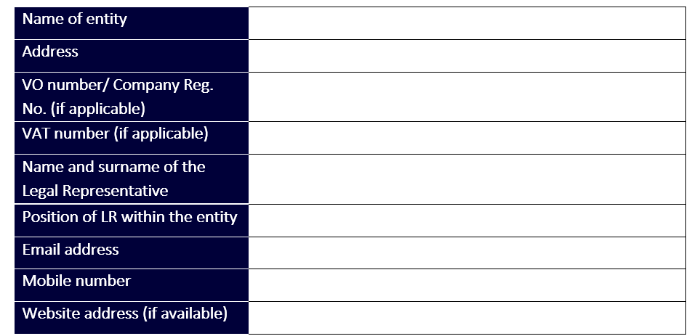
Each project must have a Project Leader who is responsible for implementation and holds overall financial and legal responsibility for the project. There must be a single Project Leader, even in cases of partnerships between entities or when the proposed operations consist of multiple components.

Slide 27
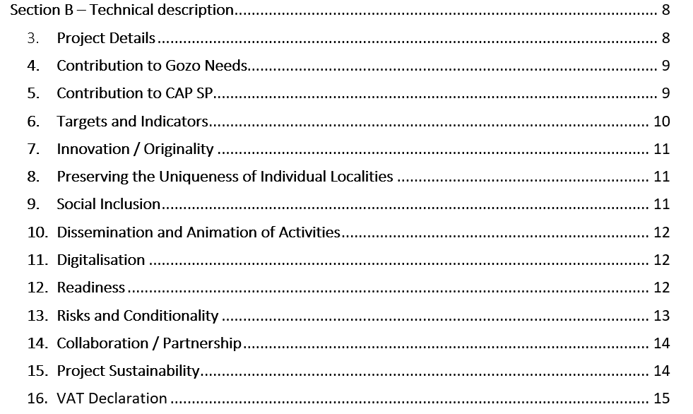
This Section contributes directly to the ranking criteria as outlined in the guidelines. All parts have to be filled by the applicant for such applications to be deemed as eligible.

Slide 28
Project Details: Include a description of the project idea, giving reasoning behind the investments. Include information on how the proposed actions and investments are to be carried out, and the aims and objectives of the project (10 marks).
Needs and objectives to be addressed: Tick and describe the Contribution to Gozo’s Needs and the Contribution towards the CAP SP objectives, making reference to the LDS (20 marks).
Indicators and Targets: Indicate the number of small-scale infrastructure interventions, number of behavioural change interventions, number of interventions enhancing green spaces, and number of affected locations which the project targets (5 marks).
Innovation / Originality: Describe how the project is innovative or original within the locality where it will be undertaken (10 marks).
Preserving the Uniqueness of Individual Localities: Explain how the project seeks to safeguard and highlight the distinct character of individual localities (5 marks).
Social Inclusion: Describe how the project aims to bring together the community to enhance their locality (5 marks).
Dissemination and Animation Activities: Describe how the project will be disseminated and/or promoted within the community of the locality (5 marks).
Digitalisation: Describe whether the project incorporates any form of digitalisation as part of its scope (5 marks).

Slide 29
Readiness: Readiness refers to project proposals that are in an advanced state of preparedness, showing evidence that necessary consultations with relevant competent authorities/stakeholders have taken place. Kindly list the activities that require a planning or environmental permit, specify whether the permit application has already been obtained or submitted, and, if applicable, provide the Permit Number or Tracking Number (10 marks).
Risks and Conditionality: Explain the risks and conditions associated with the project, and briefly provide any mitigation and/or preventive measures, as well as the actions to be taken in the event of an adverse occurrence. Include an explanation of risks related to financial management, implementation, capacity, legal compliance, logistics, and procurement(5 marks).
Collaboration/Partnership: Partnership between entities is not a requirement but is encouraged through the award of additional marks (5 marks).
Sustainability: Describe and demonstrate how the benefits of the project will continue to be delivered after the grant support ends and the project is completed 6 (5 marks).
Ten (10) Marks are awarded for clarity and sequence – based on how clearly the central purpose of the proposal is conveyed, and how effectively the supporting ideas are presented in a focused and logical sequence. Consideration is given if relevant details enhance and enrich the overall proposal.

Slide 31
Supporting Documentation: The applicant must submit the necessary relevant documentation, such as Tax Compliance Status, Audited Financial Statements, among others.
Financial Standing: Applicant confirms its financial standing and ability to continue conducting activities as a going concern, and that it has sufficient financial resources to meet its own co-financing obligation.
Indicative implementation timetable: Applicants provide the envisaged schedule for each investment component.
De Minimis Declaration: State aid implications will arise in the case of applicants that carry out an economic activity within the meaning of Article 107 TFEU, as well as applications proposing a project involving an economic activity. The total amount of de minimis aid granted shall not exceed the amount of €300,000 over any period of three years.
Declaration Form: Applicant confirms that they abide by the stipulated declarations.

Slide 32
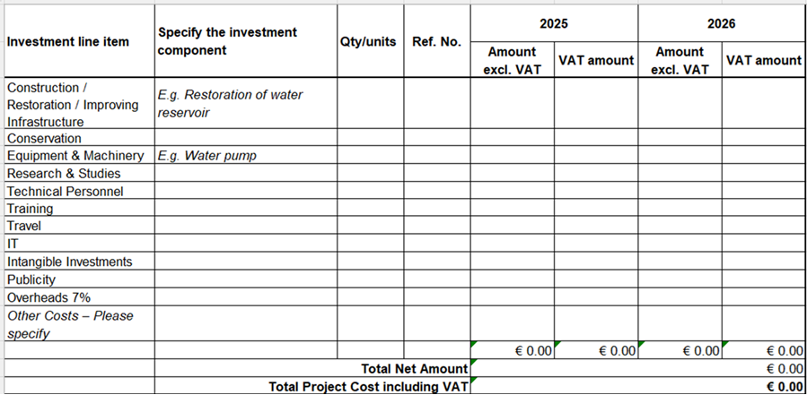
Project Costs are to be completed in a separate annex (Excel sheet). The list of proposed investment components to be co-financed by the project should be inserted. The total amounts will be calculated automatically. Investment components should be amended as required. All costs must be provided in euros.
An indirect cost of 7% will be applied on the total eligible costs that will cover any overheads incurred by the Beneficiary.

Slide 33
Application submissions in hard copy, whether submitted by mail, by hand or other means, will NOT be accepted.
In cases where applicable documentation is still missing at the time of the application, the GAGF will request the applicant to rectify the situation and will allow a period of five (5) working days from the date of notification to submit the missing documentation and/or information.

Slide 34
Q&A

